Slide 1
Some revision notes
(if you ONLY study this is would NOT be enough)
Chs 14 and 16
(relevant to both open and MC questions)
Self-study
Slides by Prof C Rootman

Slide 2
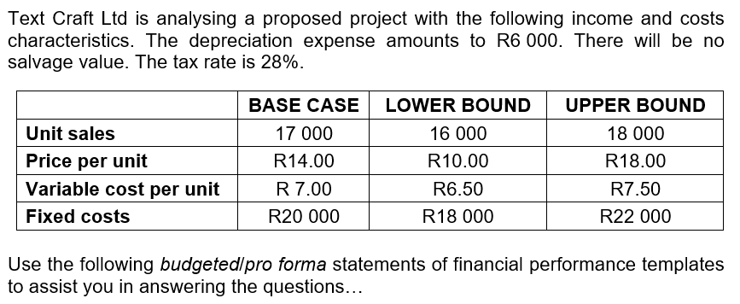
Chapter 14 Scenario analysis; (can you do sensitivity?)

Slide 3
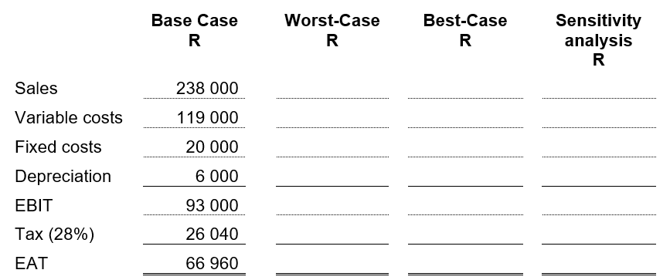

Slide 4
Chapter 14 Scenario analysis; (can you do sensitivity?)
Those are the figures to use for the best-case
Do you know which figures to use for the worst-case?

Slide 5
 | Base case | Best-case | Worst-case | Sensitivity analysis
 | R | R | R | R
Sales | 238 000 | 324 000
VC | 119 000 | 117 000
FC | 20 000 | 18 000
Depreciation | 6 000 | 6 000
EBIT | 93 000 | 183 000
Tax (28%) | 26 040 | 51 240
EAT | 66 960 | 131 760
What type of Qs can be asked?
Also now try a sensitivity analysis: with the SP the sensitive variable (let’s say they will go through a low sales period)…

Slide 6
What if it is a sensitivity analysis? When ONE variable changes/is “sensitive”… Which figures will you use? Base case figures for ALL, except use another figure for the one sensitive variable… For example, let’s say you need to perform a sensitivity analysis: FC is sensitive and the firm forecast a difficult time (a worse situation): Use for ALL variables the BASE case figures, except for FC you will you the UPPER bound (highest) FC. And if they forecast a good next period (a best situation)…? What if VC is sensitive? Etc.

Slide 7
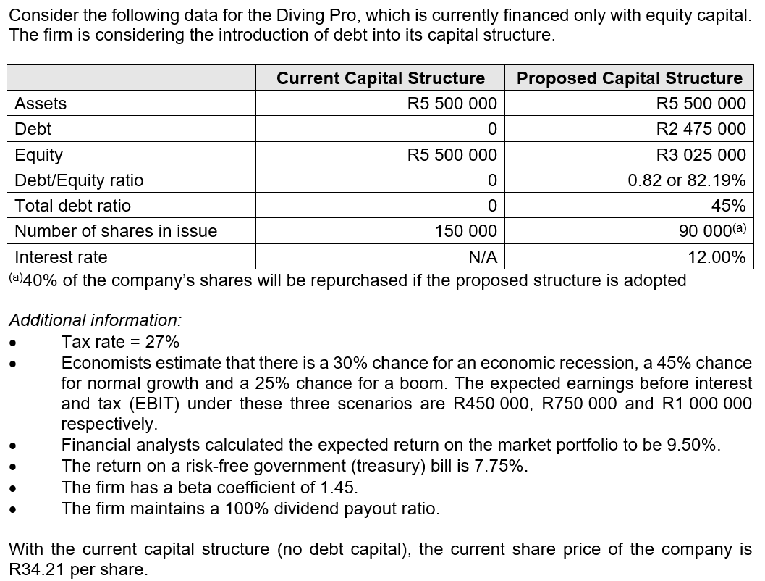
Chapter 16 Capital structure

Slide 8
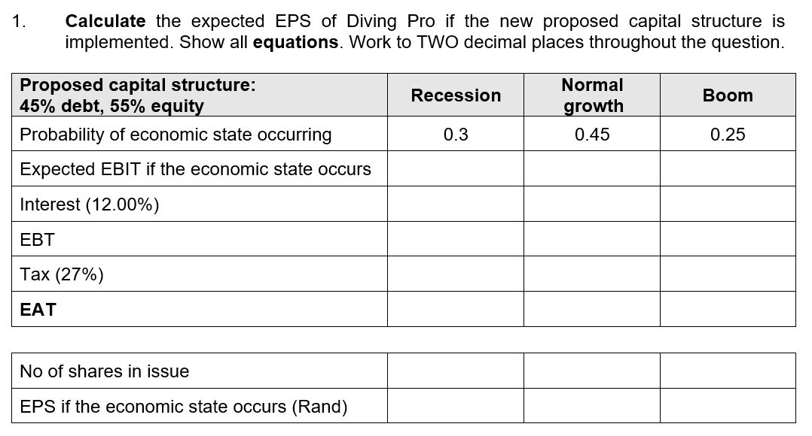

Slide 9
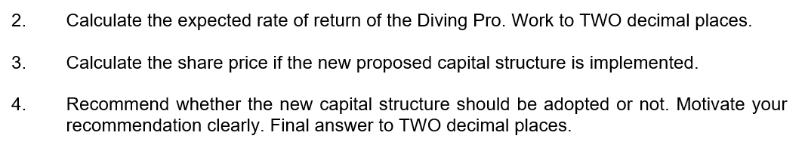

Slide 10
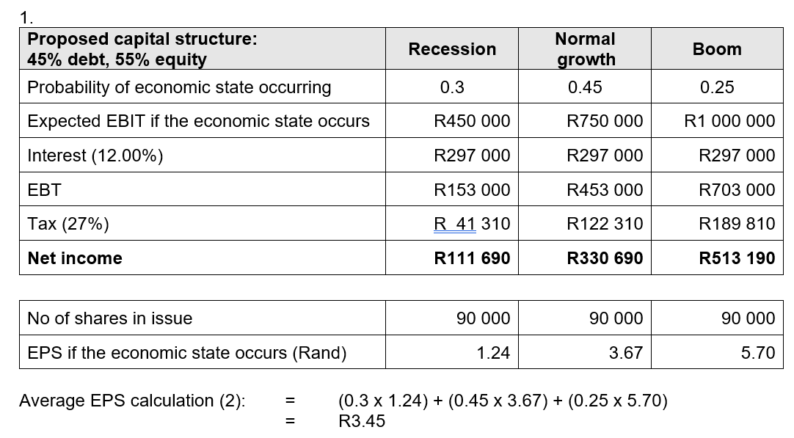

Slide 11
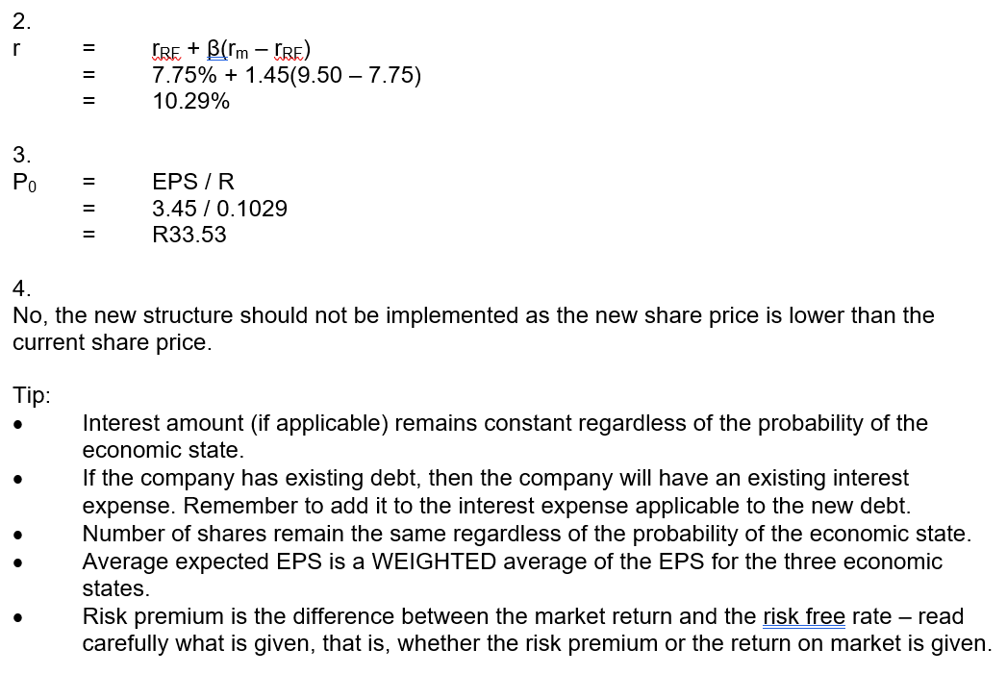
Another tip: Number of shares can still change, in a situation were more (additional) shares are issued. Remember then to add the new number to the existing number of shares in issue.

Slide 12
Happy studying!
More revision notes and examples: SG, Funda (remember Chs 13 and 15), textbook, etc.
Remember to use the overview slides as well as the Exam guidelines & layout that were discussed in class, etc.

